Slide 1

RADIANT POWER
Waste2Watts Initiative

Slide 2
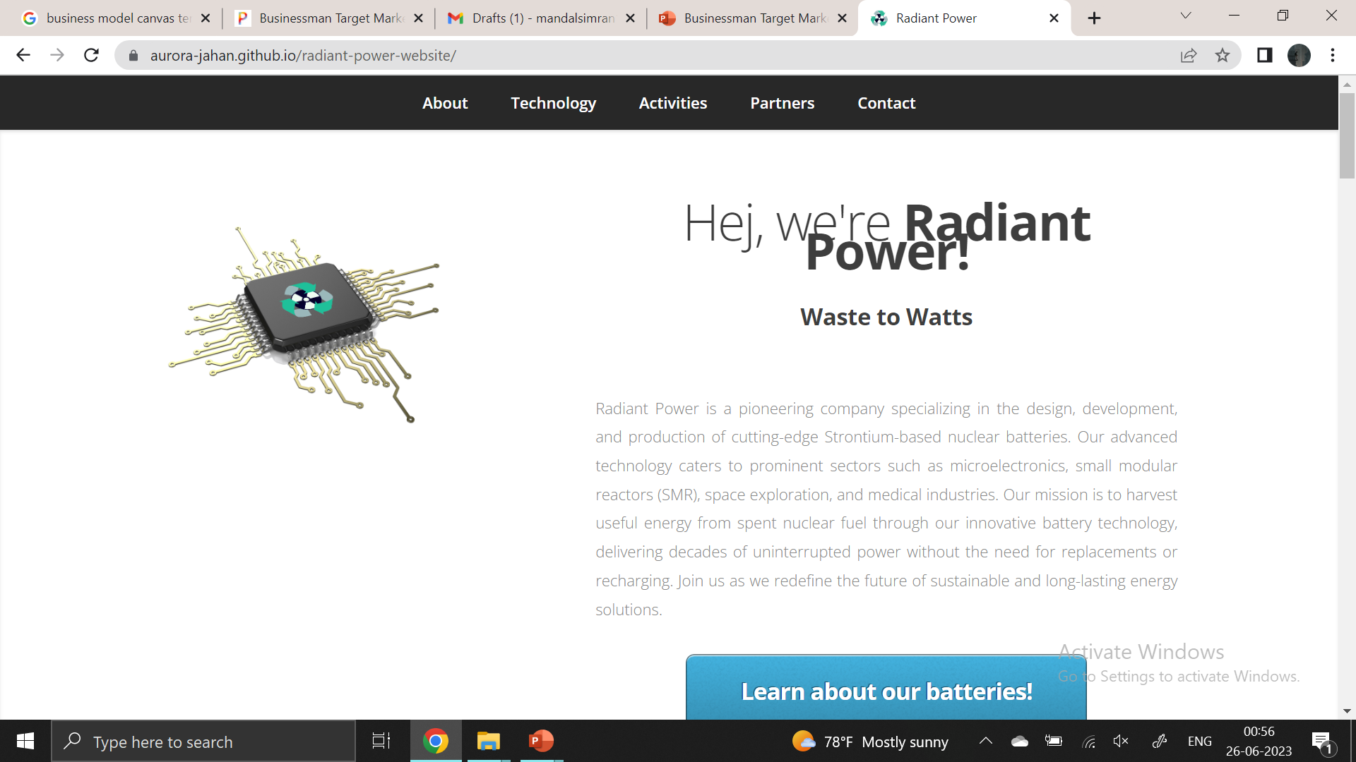
Radiant Power Waste2Watts
About us
Radiant Power is a pioneering company that designs, develops, and produces cutting-edge Strontium-based nuclear batteries. Our advanced technology caters to prominent sectors such as microelectronics, small modular reactors (SMR), space exploration, and medical industries. Our mission is to harvest useful energy from spent nuclear fuel through our innovative battery technology, delivering decades of uninterrupted power without replacing or recharging.

Slide 3
History
Nuclear Battery
To provide uninterrupted electricity to military off-grid sites for sea and air surveillance using Pu-238 and applying it to a Stirling engine to generate electricity.
Initial
Step
Final Step
2nd Step
Nuclear Battery
Radiant Battery
To provide uninterrupted electricity to cellphone towers by harvesting decay heat from decaying nuclear waste (Pu-239)
Developing and commercializing long lasting strontium batteries, from spent nuclear fuel inventory to power small devices of varying functions

Slide 4
PRODUCT
DESCRIPTION
Developing and Commercializing Strontium Beta Voltaic Batteries
Converts energy from decaying beta particles into reliable and predictable electricity
Independent of temperature differences
Long lifespan
Sustainable and safe energy solution
Predictable
Powering small devices for various industries
Providing constant power output

Slide 5

Customer Analysis

Slide 6
Identified customer
01
02
SMR
Space exploration
Our early adaptors for sensors.
They are also our early adaptors.
03
04
Military applications
Medical applications
Military application equipment has more lenient laws than civilian laws.
These would be our prospects.

Slide 7
CUSTOMER ANALYSIS
TAM: microelectronics, medical devices, electric vehicles, aerospace and defense, renewable energy storage, consumer electronics, and the Internet of Things (IoT).
SAM: (SMRs). Radiant power in SMRs can be used to control the plant and monitor its safety. As of 2022, there are about 70 SMR designs in various stages of design, construction, and operation. Usually, a typical reactor requires about 2000 sensors.
SOM: The serviceable obtainable market encompasses the 14 SMR designs by the United States of America.
Notes:
SAM: The ability to withstand high heat and other forms of radiation makes strontium an ideal power source for SMR sensors.
SOM: This does not address the number of units available or expected to be deployed.

Slide 8

Industry Analysis

Slide 9
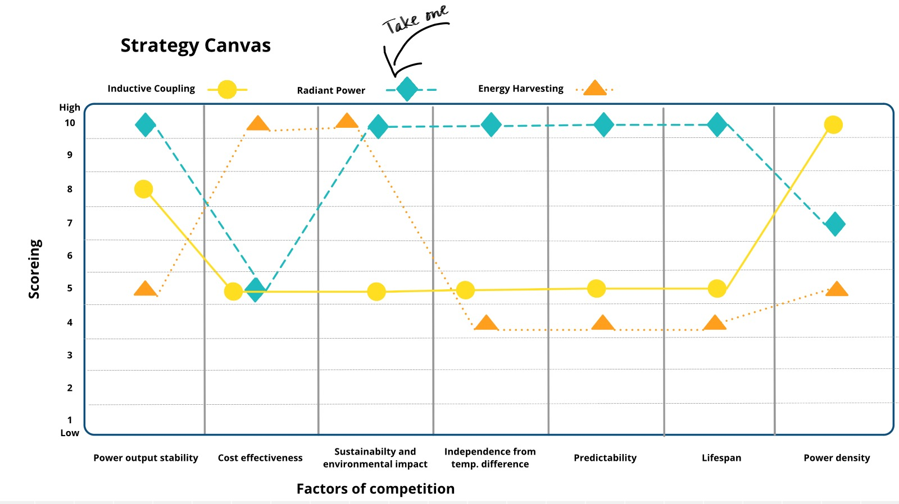
Notes:
Parameters the customer values the most

Slide 10

Business Validation

Slide 11
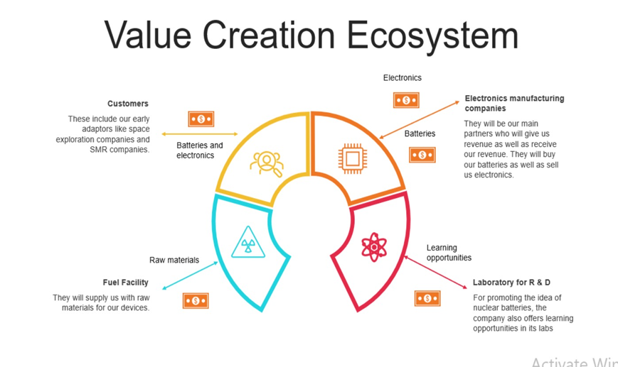


Notes:
For electronics manufacturing company: the electronics are for (temperature and pressure sensors)

Slide 12

Business Model Canvas

Slide 13
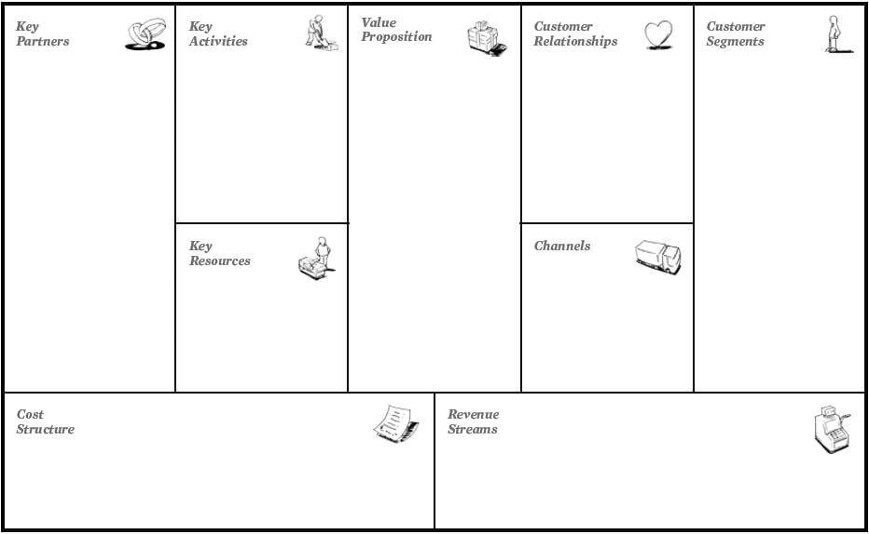
Microelectronics manufacturing company
SMR company
Space exploration
Manufacturing Company
Seminars
R & D
Assembling batteries
Reprocessing
Seminars and Conferences
Government security companies. (e.g.: Defense)
Companies with high regulatory tolerance. (e.g.: medical and sub-sea devices
Sensors companies for general use. (e.g.: Smoke detectors)
Website for sales
Nuclear battery (5-10 nW) Waste to Watts
Website for Information
Spent fuel facility
Fuel suppliers
Regulatory bodies
Engineering and scientist
Battery Technology
Sales and marketing team
National and International conferences
Assembly plant
Assembly & Reprocessing plant
Manufacturing for batteries
Lab for R & D
Reprocessing
Microelectronics manufacturing companies
Spent nuclear fuel
Sales of batteries
Technical visits from universities
Sales of other electronics made with the technology
Licensing fees

Slide 14

Minimum Viable Product

